Slide 1

CONFLICT & DEMINING IN COLOMBIA
Group 8: Alejandra Patiño, Sofía Linares & Juan Camisassa

Slide 2
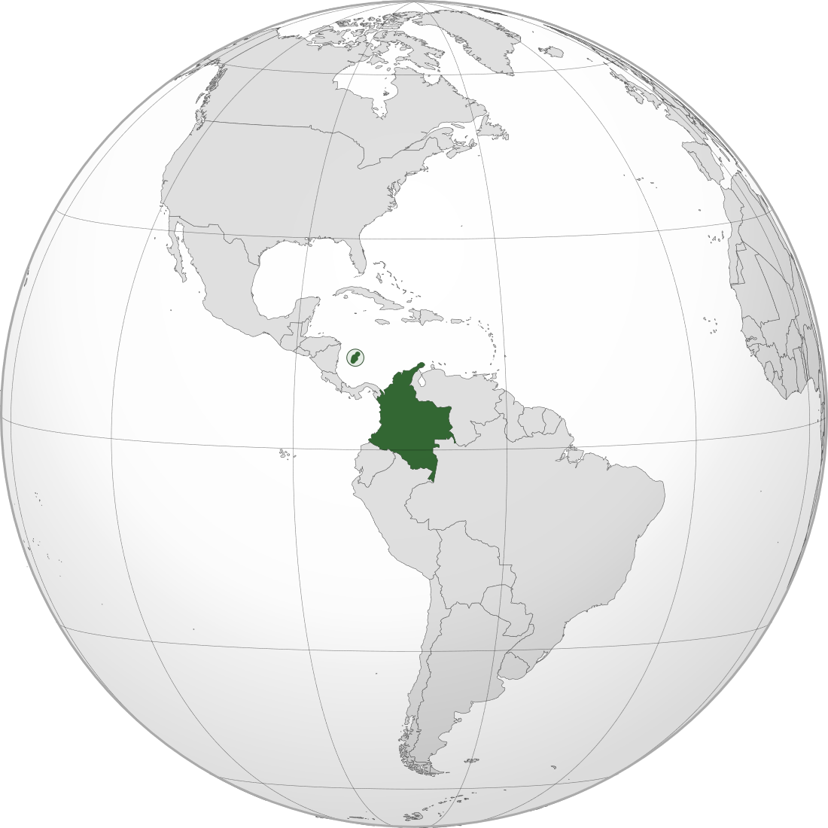
CONFLICT IN COLOMBIA
Located in South America, borders with Venezuela, Peru, Ecuador and Brazil.
Colombia has experienced prolonged armed conflict.
Ranks among the countries with the highest number of recorded conflict events, according to the UCDP Georeferenced Event Dataset (GED).
Notes:
dshdshousdhoi

Slide 3
Notes:
dshdshousdhoi

Slide 4
LANDMINES IN COLOMBIA
Beyond conflict events, Colombia has a specific territorial feature: extensive antipersonnel landmine contamination.
What is a landmine? A landmine is an explosive device placed on or under the ground that detonates when a person or vehicle triggers it.
By 2018, it was estimated to be among the top 10 countries worldwide with the highest number of victims of antipersonnel mines (MAP) and explosive remnants of war (MUSE) (Landmine Monitor, 2018).
Notes:
dshdshousdhoi

Slide 5


DATA
UCDP Georeferenced Event Dataset (GED), Global Version
This dataset provides highly disaggregated, geo-coded data on individual events of organized violence, including exact locations and dates. It enables spatial and temporal analysis of conflict intensity and distribution.
National Center for Historical Memory, Observatory of Conflict & Memory.
Public national database: Conflicto Armado en Cifras — recorded landmine and explosive device incidents, 1953–2025.
Notes:
dshdshousdhoi

Slide 6
DASHBOARD
LINK DE STREAMLIT: VER PSET.
Notes:
dshdshousdhoi

Slide 7
PEACE AGREEMENT AND DEMINING POLICY
The 2016 Peace Agreement marked a policy shift: it institutionalized demining policy.
Demining activity increases sharply after 2016, reflecting policy prioritization and discovery.
Demining increases economic growth by:
Enabling access to essential infrastructure and new markets (Chiovelli, Michalopoulos, & Papaioannou, 2019).
Opening opportunities for the use and productive exploitation of natural resources (Gunawardana, Tantrigoda, & Kumara, 2016).
Facilitating the development of productive activities, and supports land restitution processes (Cabrera & Pachón, 2017).

Slide 8
DASHBOARD
VOLVEMOS AL DASHBOARD GRÁFICO LÍNEA VERDE
Notes:
dshdshousdhoi

Slide 9
POLICY RECOMMENDATION & CONCLUSION
PRIORITIZATION AREAS WITH HIGH CONFLICT / LANDMINES BUT LESS DEMINING CASES
Notes:
dshdshousdhoi

Slide 10
Appendix

Slide 11
SMOKESELLER GRAPHS

Slide 12
QUESTIONS?

